Slide 1

ICTNWK612 Plan and manage troubleshooting advanced integrated IP networks
Telecommunications Network Engineering
Leonardo Matias Ciarcia
CTI20221062

Slide 2
Phase 4
Planning for the strategies for troubleshooting and monitoring the performance of the advanced integrated IP networks.
Management and monitoring troubleshooting strategies for complex enterprise networks
Implementation of test plans for advanced network solutions

Slide 3
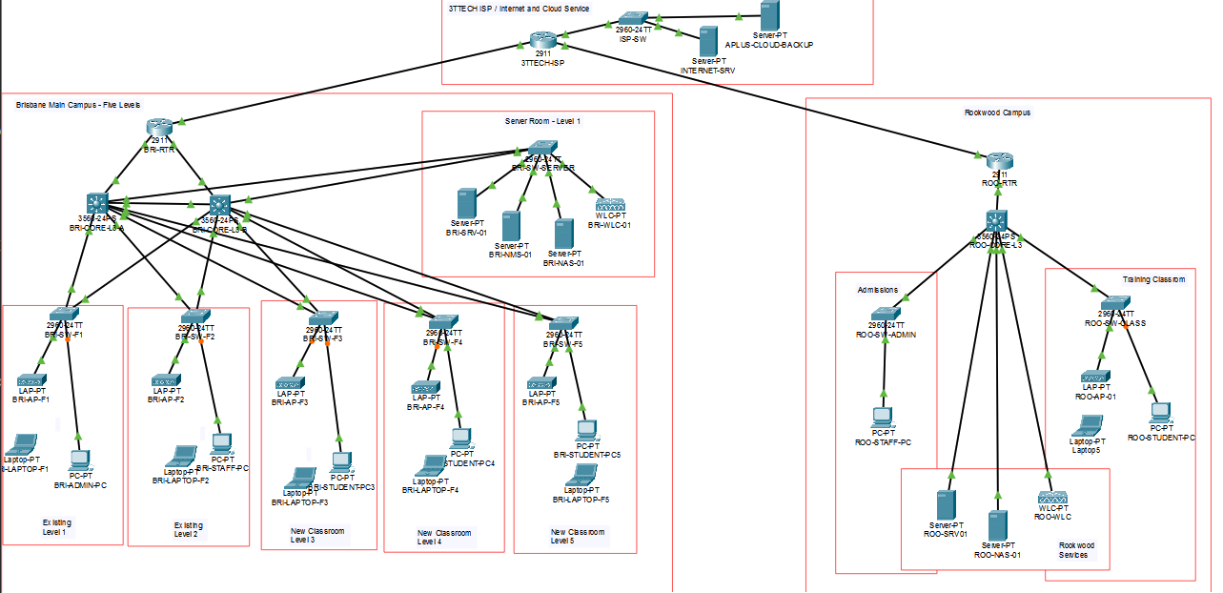
Final Network Option 2 topology

Slide 4
Monitoring Structure and Targets
Area | Monitoring requirement
Reachability | Gateways, servers, Rookwood and internet service
Latency | Local, inter-campus and external response time
Packet loss | Target of 1% or less
Utilisation | Warning from 70%; critical at 85% or above
Availability | Proposed target of 99.9% per month
Interfaces | Link state, speed, errors and discards
Security | Access attempts, ACL behaviour and configuration changes

Slide 5
Structured Troubleshooting Process
Record the fault, time, affected users and services.
Confirm the symptoms and determine the scope.
Compare the network with its last verified configuration.
Isolate the fault using the OSI model.
Test physical links, VLANs, addressing, routing and services.
Apply one authorised corrective action at a time.
Repeat the affected tests.
Document the cause, action, result and remaining risk.
Reverse the change if it creates additional problems.

Slide 6
Testing and Monitoring Tools
Cisco Packet Tracer for configuration and simulated connectivity testing
Cisco IOS show commands for interfaces, VLANs, spanning tree and routing
Ping and traceroute for reachability, delay and path checking
Wireshark for packet and protocol analysis
TamoGraph for wireless coverage and interference assessment
Configuration backups and logs for change comparison and recovery

Slide 7
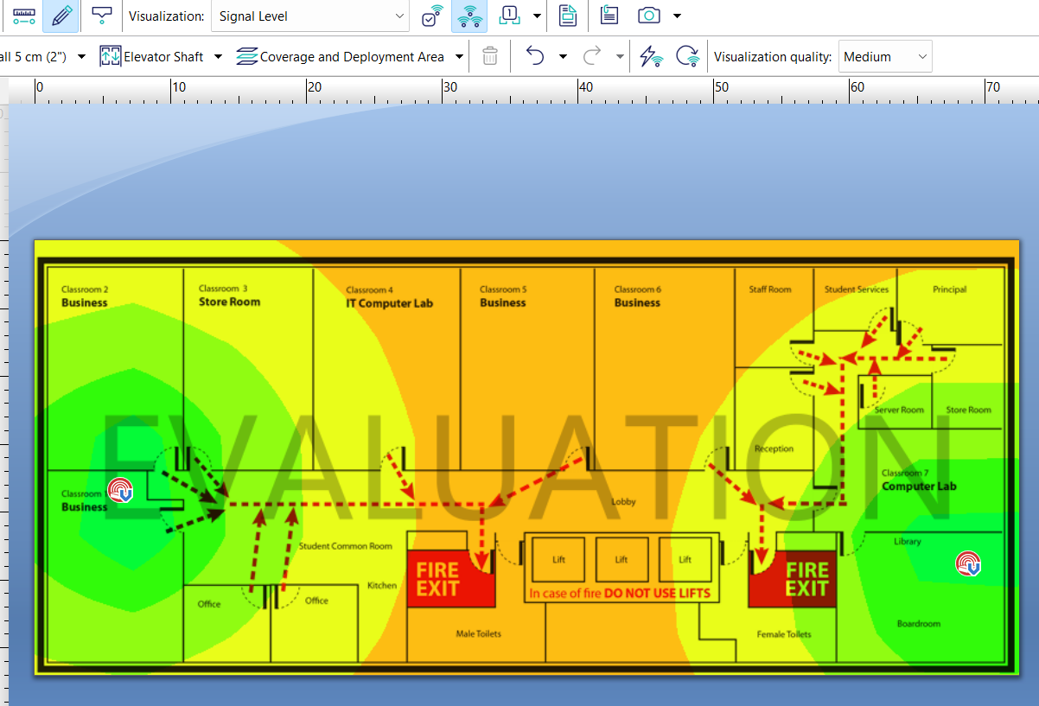
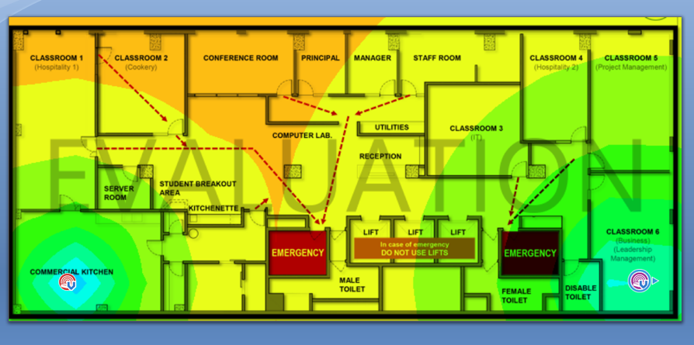
TamoGraph evidences (Level 1 & Level 2)

Slide 8
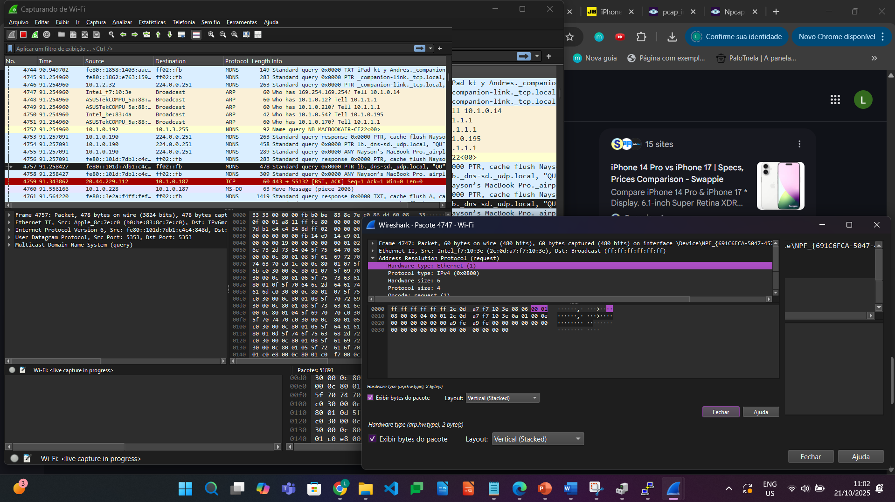
Wireshark evidences

Slide 9
Connectivity and Switching Tests
BRI-ADMIN-PC to gateway: 10.10.20.1
BRI-ADMIN-PC to Brisbane server: 10.10.40.10
BRI-ADMIN-PC to Rookwood server: 10.20.40.10
BRI-ADMIN-PC to internet server: 209.165.200.10
Rookwood user to Rookwood server: 10.20.40.10
VLAN and access-port assignments
Trunk and switch-to-switch connectivity
Spanning Tree Protocol and loop prevention
SVI status and inter-VLAN routing

Slide 10
Advanced Services and Identified Limitation
DHCP must provide the correct IP address, mask and default gateway.
DNS and authorised server access must operate from the required VLANs.
IPv4 and IPv6 configurations must be monitored separately.
ACLs and VLAN separation must prevent unauthorised access.
Private VLAN commands were not supported in the selected Packet Tracer device.
The supplementary protected-port test did not successfully demonstrate isolation in the latest recorded attempt.
Full PVLAN testing requires a platform that supports primary, secondary, isolated, community and promiscuous VLAN roles.

Slide 11
IOS and Configuration Maintenance
Review interface, routing and security logs regularly.
Back up verified running and startup configurations.
Compare current configurations with approved baselines.
Review routing tables, default routes and VPN status.
Check IOS compatibility and security notices before upgrades.
Verify image files and maintain a rollback copy.
Perform upgrades during an approved maintenance window.
Retest routing, VLANs, DHCP, DNS, VPN and internet access after maintenance.

Slide 12
Risks, Contingencies and Recovery
Reverse unsuccessful configuration changes using a verified backup.
Use the remaining Brisbane core path when a core or uplink fails.
Continue local campus services during a 3TTech or VPN outage.
Use wired access when an AP or wireless controller fails.
Restore data from verified NAS or off-site backups.
Reschedule non-urgent transfers when sustained congestion occurs.
Correct security or isolation failures before restoring full access.
Record recovery time, outcome and outstanding actions.

Slide 13
References
ICTNWK612 Learner Guide
WireShark Fundations
TamoSoft Ltd., “TamoGrapf Site Survey”
Cisco Systems

